Slide 1
Chapter 15
Abstract Classes and Interfaces

Slide 2
List of contents
Abstract Method and Abstract Class
Interfaces in Python
Abstract classes vs. Interfaces

Slide 3
Introduction
We know that a class is a model for creating objects (or instances). A class contains attributes and actions. Attributes are nothing but variables and actions are represented by methods.
When objects are created to a class, the objects also get the variables and actions mentioned in the class. The rule is that anything that is written in the class is applicable to all of its objects. If a method is written in the class, it is available to all the class objects.
For example, take a class Myclass that contains a method calculate() that calculates square value of a given number. If we create three objects to this class, all the three objects get the copy of this method and hence, from any object, we can call and use this method.
Consider example program
Go to Jupyter notebook for example

Slide 4
Of course, in the preceding program, the requirement of all the objects is same, i.e., to calculate square value. Then this program is alright.
But, sometimes the requirement of the objects will be different and entirely dependent on the specific object only. For example, in the preceding program, if the first object wants to calculate square value, the second object wants the square root value and the third object wants cube value.
In such a case, how to write the calculate() method in Myclass?
Since, the calculate() method has to perform three different tasks depending on the object, we cannot write the code to calculate square value in the body of calculate() method. On the other hand, if we write three different methods like calculate_square(), calculate_sqrt(), and calculate_cube() in Myclass, then all the three methods are available to all the three objects which is not advisable. When each object wants one method, providing all the three does not look reasonable.
To serve each object with the one and only required method, we can follow the steps:
First, let's write a calculate() method in Myclass. This means every object wants to calculate something.
If we write body for calculate() method, it is commonly available to all the objects. So let's not write body for calculate() method. Such a method is called abstract method. Since, we write abstract method in Myclass, it is called abstract class.
Now derive a sub class Sub1 from Myclass, so that the calculate() method is available to the sub class. Provide body for calculate() method in Sub1 such that it calculates square value. Similarly, we create another sub class Sub2 where we write the calculate() method with body to calculate square root value. We create the third sub class Sub3 where we write the calculate() method to calculate cube value. This hierarchy is shown in Figure (next slide)
It is possible to create objects for the sub classes. Using these objects, the respective methods can be called and used. Thus, every object will have its requirement fulfilled

Slide 5
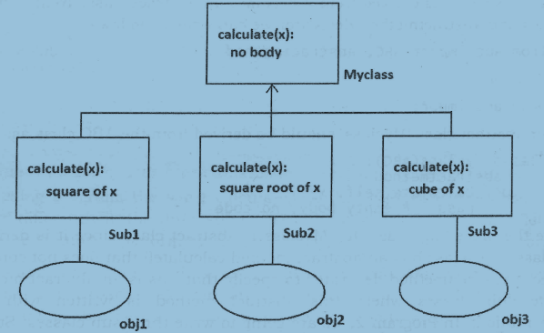

Slide 6
Abstract Method and Abstract Class
An abstract method is a method whose action is redefined in the sub classes as per the requirement of the objects. Generally abstract methods are written without body since their body will be defined in the sub classes anyhow. But it is possible to write an abstract method with body also. To mark a method as abstract, we should use the decorator @abstractmethod. On the other hand, a concrete method is a method with body.
An abstract class is a class that generally contains some abstract methods. Since, abstract class contains abstract methods whose implementation (or body) is later defined in the sub classes, it is not possible to estimate the total memory required to create the object for the abstract class.
So, PVM cannot create objects to an abstract class.
Once an abstract class is written, we should create sub classes and all the abstract methods should be implemented (body should be written) in the sub classes. Then, it is possible to create objects to the sub classes.
In the following Program, we create Myclass as an abstract super class with an abstract method calculate(). This method does not have any body within it. The way to create an abstract class is to derive it from a meta class ABC that belongs to abc (abstract base class) module as:
class Abstractclass(ABC):
Since all abstract classes should be derived from the meta class ABC which belongs to abc (abstract base class) module, we should import this module into our program. A meta Class is a class that defines the behavior of other classes. The meta class ABC defines that the class which is derived from it becomes an abstract class
Go to Jupyter notebook for example program

Slide 7
Let's take another example to understand the abstract class concept in a better way.
We see many cars on the road. These cars are all objects of Car class. For example, Maruti, Santro, Benz are all objects of Car class. Suppose, we plan to write Car class, it contains all the attributes (variables) and actions (methods) of any car object in the world.
For example, we can write the following members in Car class:
Registration number: Every car will have a registration number and hence we write this as an instance variable in Car class. All cars whether it is Maruti or Santro should have a registration number. It means registration number is a common feature to all the objects. So, it can be written as an instance variable in the Car class.
Fuel tank: Every car will have a fuel tank, opening and filling the tank is an action. To represent this action, we can write a method like: openTank()
How do we open and fill the tank? Take the key, open the tank and fill fuel. Let's assume that all cars have same mechanism of opening the tank and filling fuel. So, the code representing the opening mechanism can be written in openTank() method's body. So it becomes a concrete method. A concrete method is a method with body.
Steering: Every car will have a steering wheel and steering the car is an action. For this, we write a method as: steering()
How do we steer the car? All the cars do not have same mechanism for steering. Maruti cars have manual steering. Santro cars have power steering. So, it is not possible to write a particular mechanism in steering() method. So, this method should be written without body in Car class. Thus, it becomes an abstract method.
Brakes: Every car will have brakes. Applying brakes is an action and hence it can be represented as a method, as: braking()

Slide 8
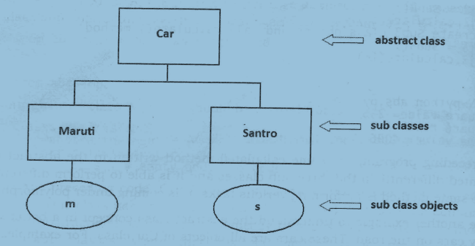
Go to IDLE for example

Slide 9
Interfaces in Python
We learned that an abstract class is a class which contains some abstract methods as well as concrete methods also.
Imagine there is a class that contains only abstract methods and there are no concrete methods. It becomes an interface.
This means an interface is an abstract class but it contains only abstract methods. None of the methods in the interface will have body. Only method headers will be written in the interface. So an interface can be defined as a specification of method headers.
Since, we write only abstract methods in the interface, there is possibility for providing different implementations (body) for those abstract methods depending on the requirements of objects.
In the languages like Java, an interface is created using the key word 'interface' but in Python an interface is created as an abstract class only. The interface concept is not explicitly available in Python. We have to use abstract classes as interfaces in Python.

Slide 10
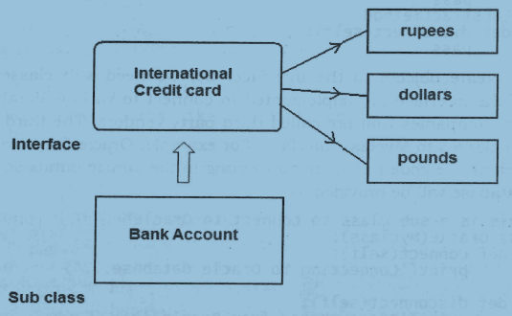
Interface Examples

Slide 11
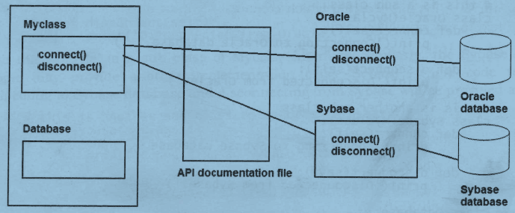
Let's see how the interface concept is advantageous in software development.
A programmer is asked to write a Python program to connect to a database and retrieve the data, process the data and display the results in the form of some reports. For this purpose, the programmer has written a class to connect to database
Go to Jupyter notebook for example program

Slide 12
Let's take another example where interface is used.
We want to write Printer interface which is used to send data to different printers. This interface has a method printit() that sends text to the printer and another method disconnect() that disconnects the printer after printing is done.
Of course, this program is a model how the printer interface can be used. It does not send the text to a real printer. On the other hand, it displays the text on the screen.
Go to Jupyter notebook for example program

Slide 13
Abstract classes vs. Interfaces
Python does not provide interface concept explicitly. It provides abstract classes which can be used as either abstract classes or interfaces. It is the discretion of the programmer to decide when to use an abstract class and when to go for an interface.
Generally, abstract class is written when there are some common features shared by all the objects as they are. On the other hand, the programmer uses an interface if all the features need to be implemented differently for different objects.
There is a responsibility for the programmer to provide the sub classes whenever he writes an abstract class. This means the same development team should provide the sub classes for the abstract class. But if an interface is written, any third party vendor will take the responsibility of providing sub classes. This means, the programmer prefers to write an interface when he wants to leave the implementation part to the third party vendors.
In case of an interface, every time a method is called, PVM should search for the method in the implementation classes which are installed elsewhere in the system and then execute the method. This takes more time. But when an abstract class is written, since the common methods are defined within the abstract class and the sub classes are generally in the same place along with the software, PVM will not have that much overhead to execute a method. Hence, interfaces are slow when compared to abstract classes.

